Slide 1

Usage-Aware LLM Survey
Prioritization and Insights
[Company Name]
PRESENTED TO
PRESENTED BY
Leadership Team
[Presenter Name]

Slide 2

The Challenge of Survey Overload
NAVIGATING EXCESSIVE FEEDBACK EFFICIENTLY
Teams face hundreds of unprioritized comments.

Slide 3
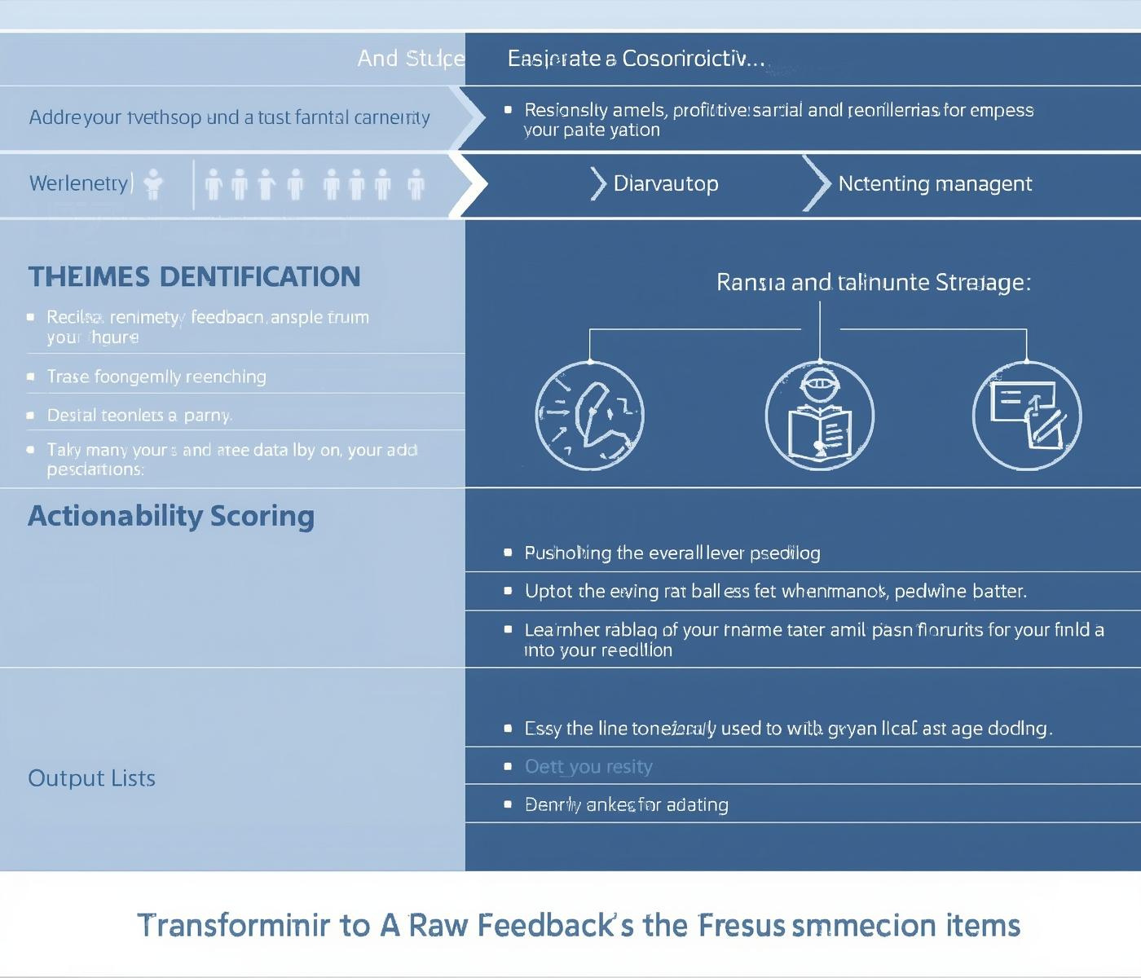
Achieving Actionable Insights from Feedback
TRANSFORMING COMMENTS INTO PRIORITIZED ACTION ITEMS
Our solution enables teams to focus on high-impact issues.

Slide 4
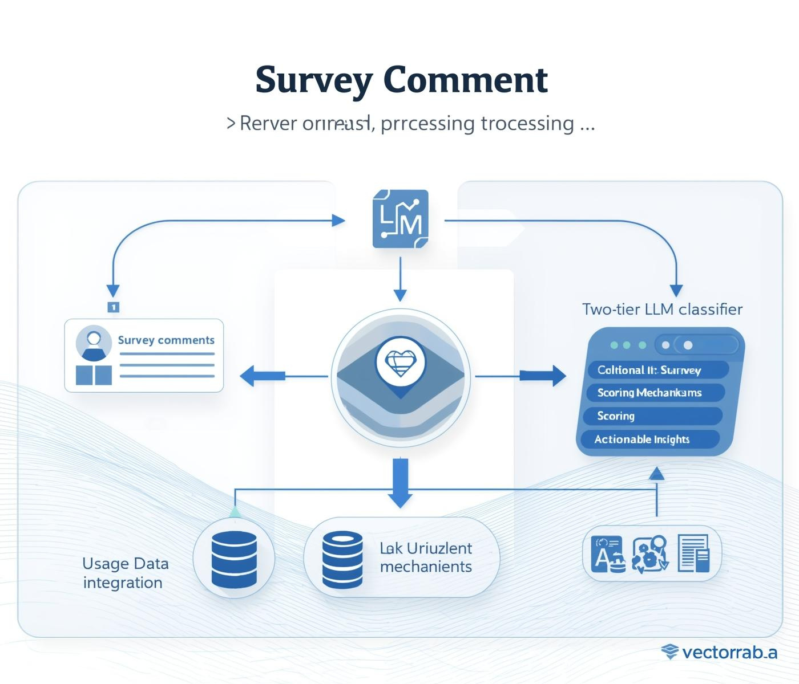
From Survey Comments to Actionable Insights
TRANSFORMING COMMENTS INTO PRIORITIZED ACTIONS
Our system processes survey comments into structured insights.

Slide 5
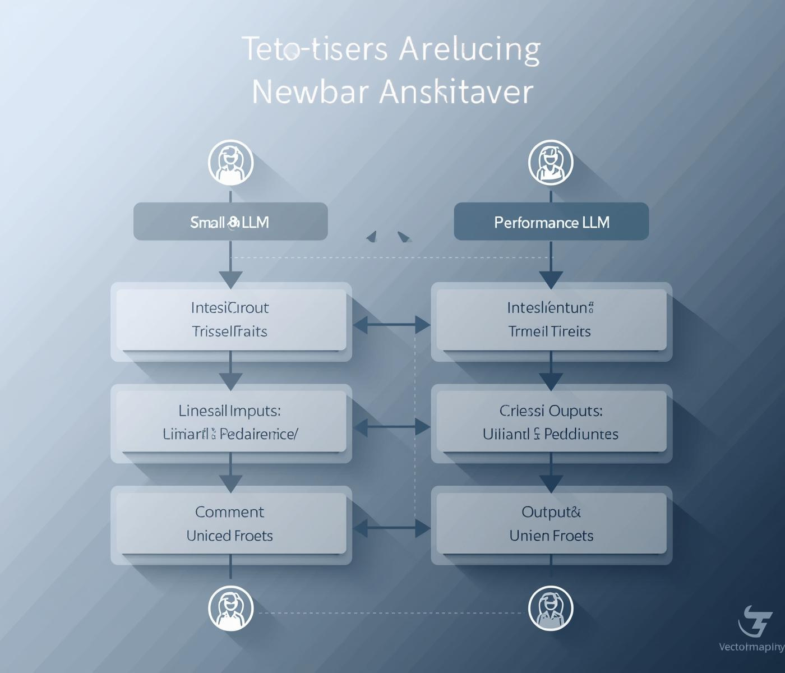
Efficient Classification Using Two-Tier LLMs
STREAMLINED THEME ASSIGNMENT FOR COMMENTS
This system minimizes costs while maximizing accuracy.

Slide 6

Connecting Survey Comments to Usage
MAPPING FEEDBACK TO REAL USER ACTIONS
By linking each comment to usage analytics, we ensure relevance.

Slide 7
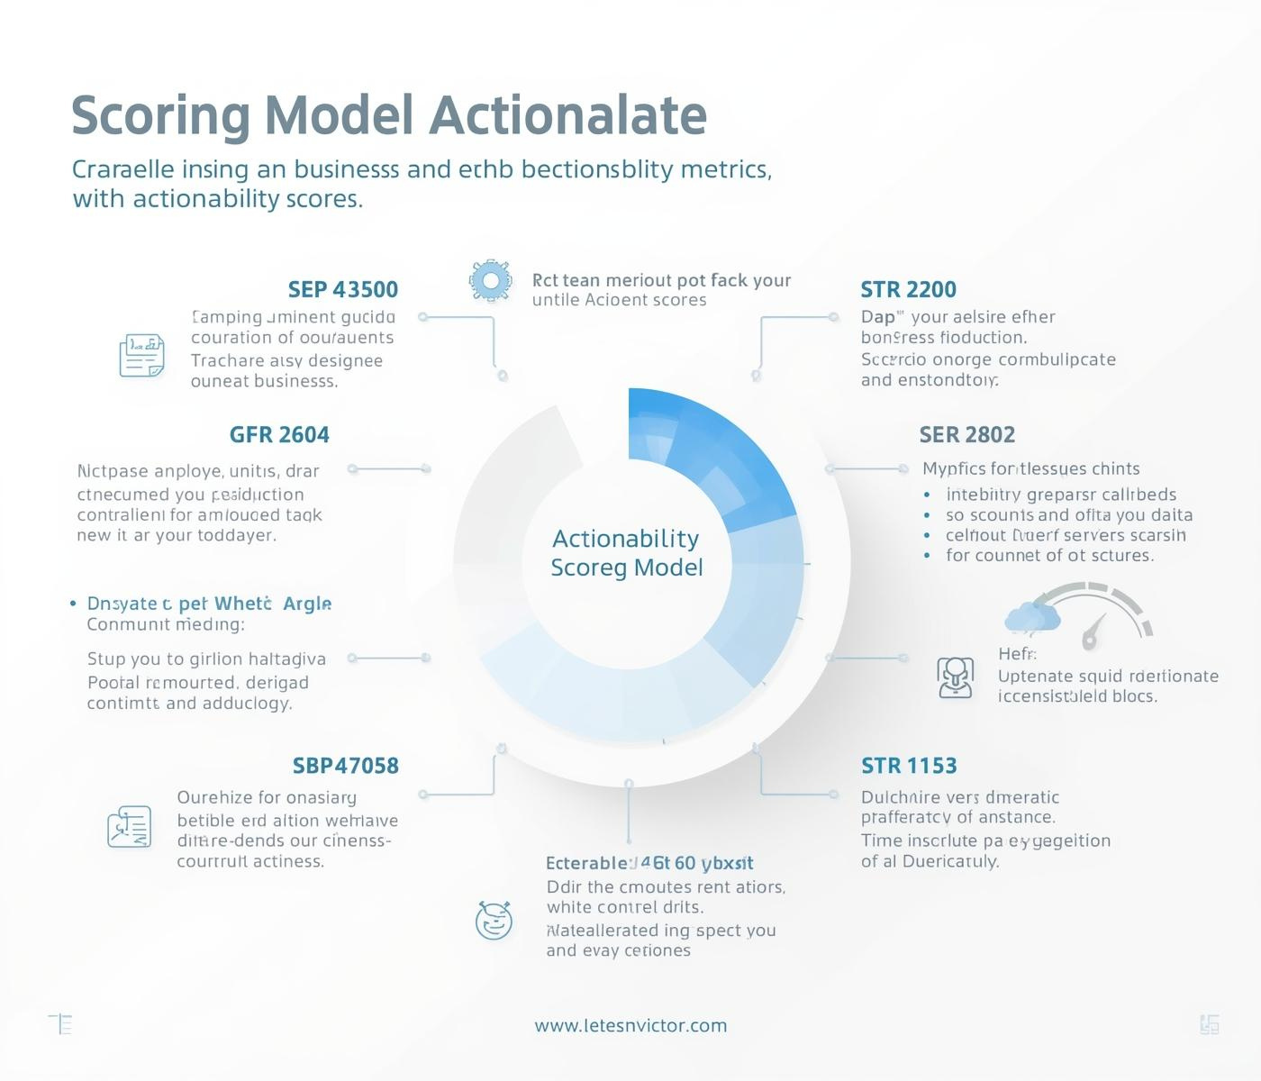
Actionability Scoring: Quantifying Feedback Impact
MEASURING IMPACT THROUGH SCORING METRICS
The scoring model combines user usage data with sentiment.

Slide 8

Explainable Actionability Through LLM Insights
UNDERSTANDING SCORES WITH CLEAR EXPLANATIONS
Each score is accompanied by a concise, human-readable reason.

Slide 9

High-Priority Feedback from ACH Power Users
PRIORITIZING ACTIONABLE USER CONCERNS
Feedback from high-usage users yields crucial insights.

Slide 10
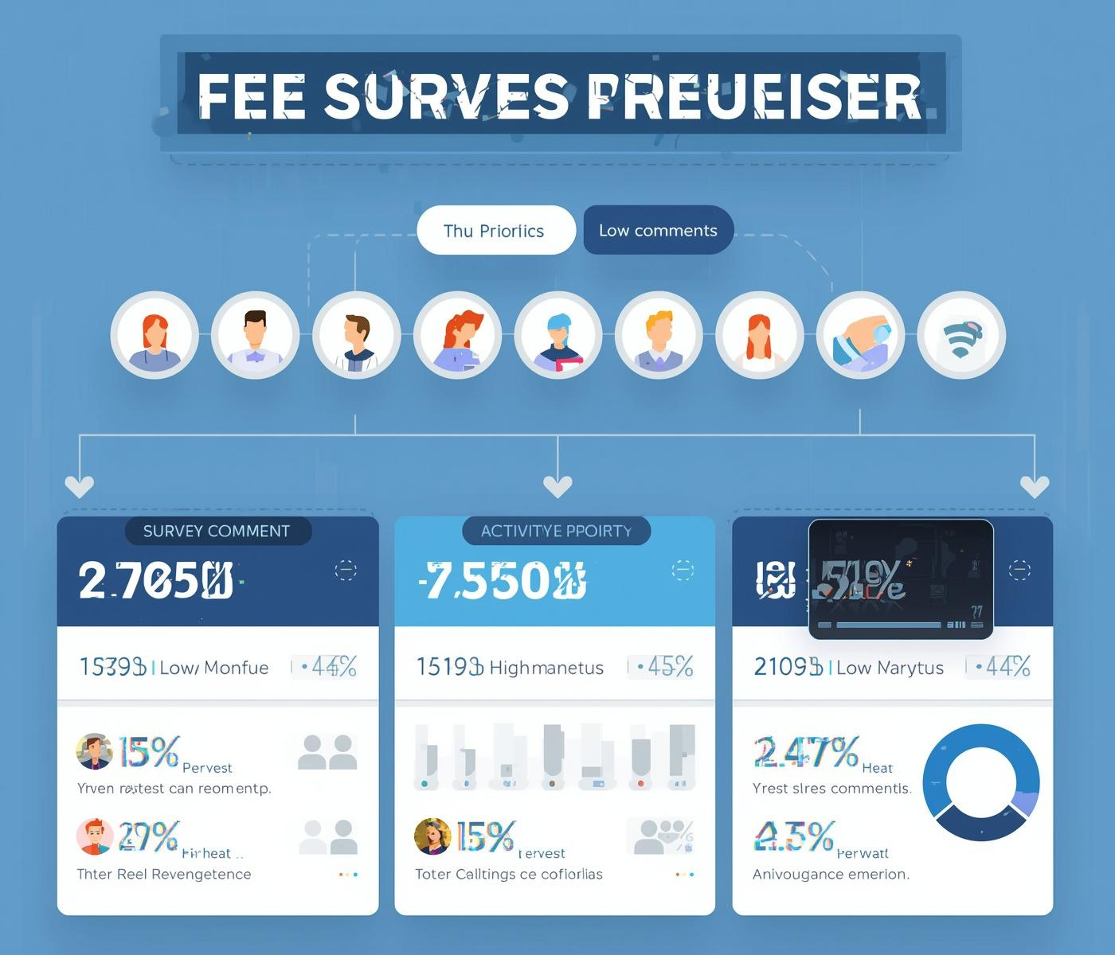
Low-Usage Statements: A Case Study
UNDERSTANDING LOWER PRIORITY FEEDBACK
Low-usage comments may not require immediate action.

Slide 11

Transforming Feedback into Actionable Insights
CREATING VALUE THROUGH NOVEL ORCHESTRATION
This system turns survey data into actionable insights.

Slide 12

Next Steps
EMAIL
hello@reallygreatsite
SOCIAL MEDIA
PHONE
@reallygreatsite
123-456-7890

